Slide 1
Why are we making a webshop?
Most online businesses already have their own website.
A webshop requires much less maintenance cost
With a webshop a business can reach a much higher audience
Making a website for a business can be considered a standard requirement
Conclusion:
Today every business should consider having an online platform,
because it makes the difference,
nowadays this fact is widely recognised and more and more
sites are being created to offer a place for online transactions.

Slide 2
Our shop
NASAPC offers a highly scalable platform for an actual
webshop capable of fulfilling every function a modern webshop should
have and more, on top of providing a great consumer experience.
This is how:
We provide a stabile and fast background for our shop
Website is visually appealing
With a dedicated mobile application, shopping is easier than ever

Slide 3
Frontend
Frontend overview
Introduction
Core components
User management
Products (registered user/guest)
Admin page (CRUD)
Selenium
Frontend conclusion
What I’v learned
Understanding VUE.js
Future development

Slide 4
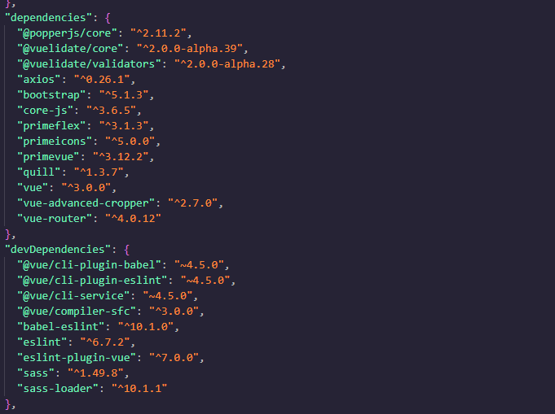
Core components

Slide 5
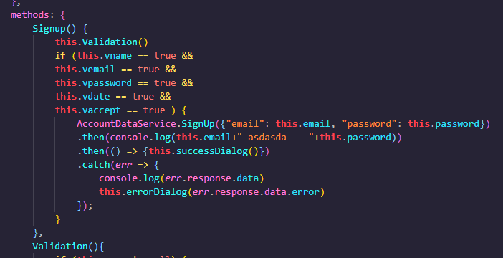
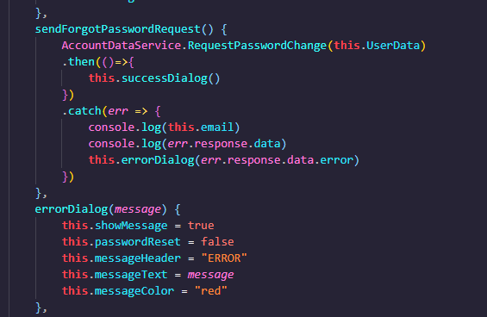
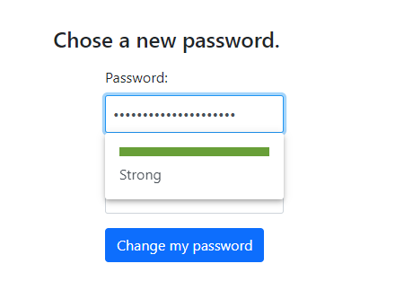
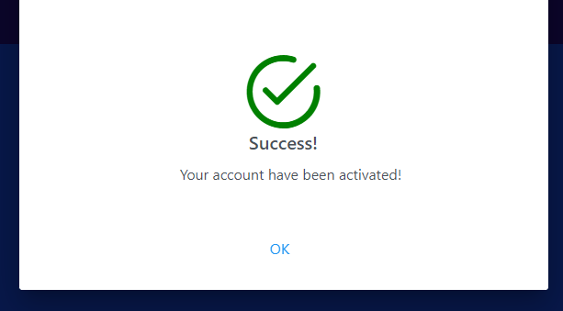
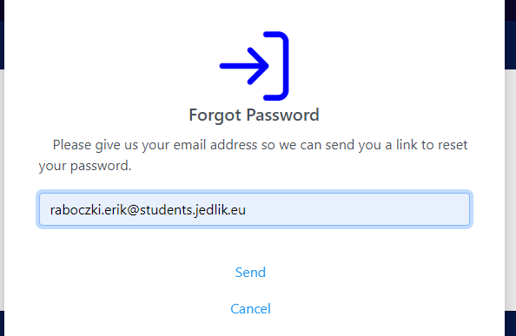
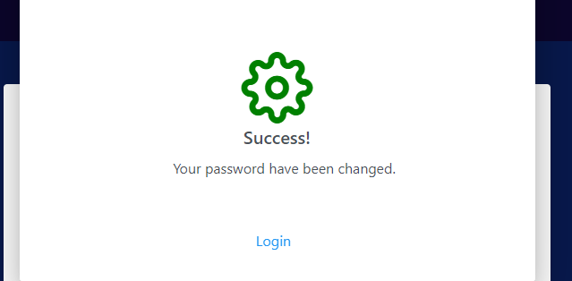
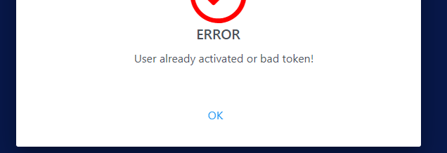
User management
Signup/Login/Forgot Password

Slide 6
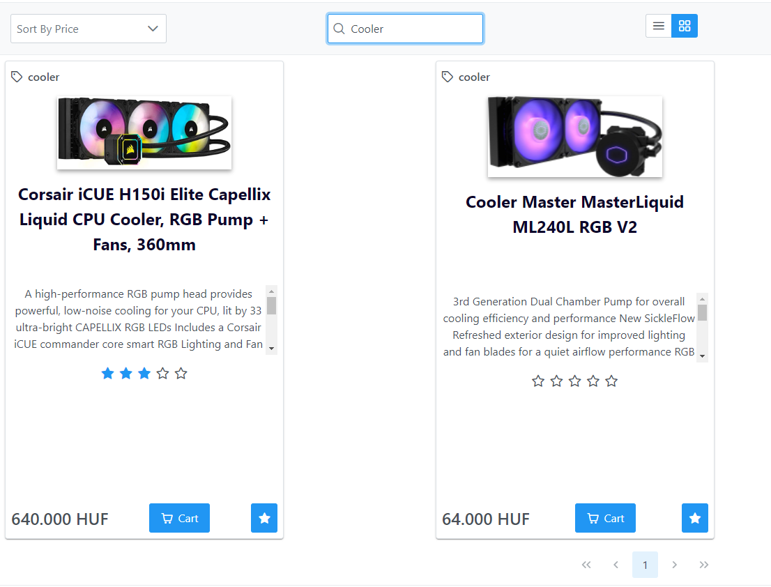
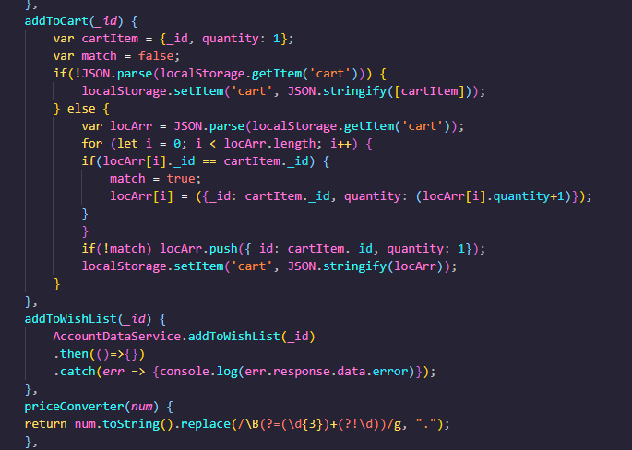
Products (registered user/guest)
Cart & Wishlist

Slide 7
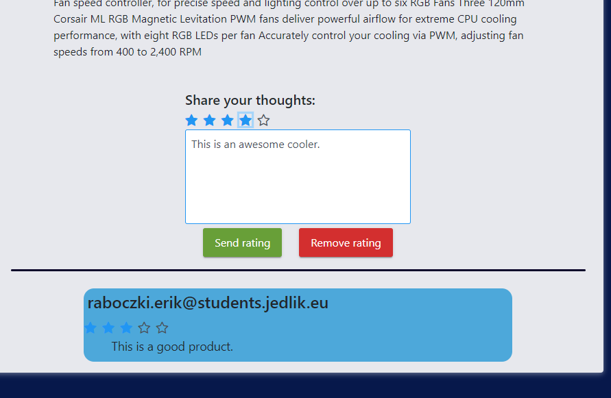
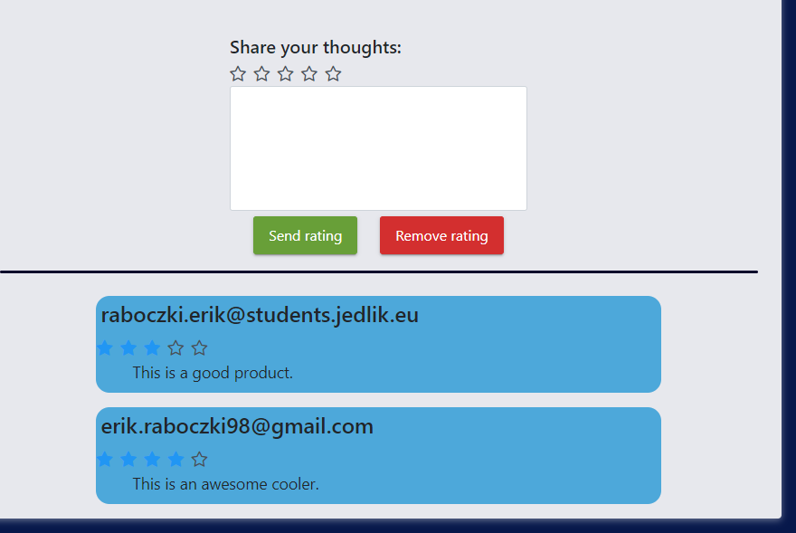
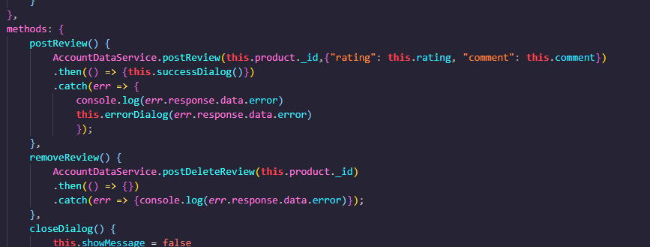
Products (registered user/guest)
Details & Feedback

Slide 8
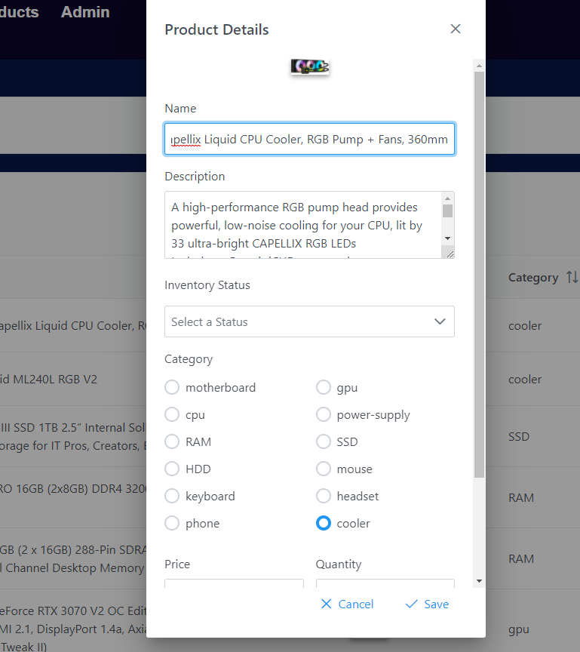
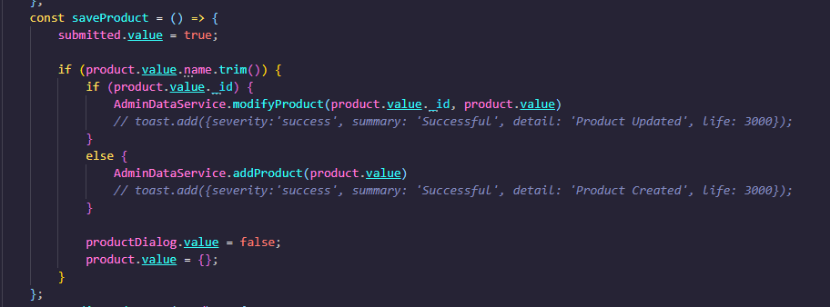
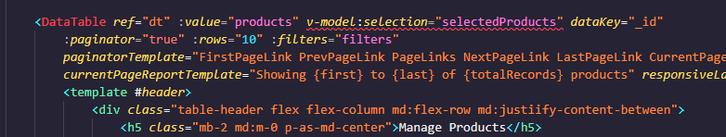
Admin page (CRUD)

Slide 9
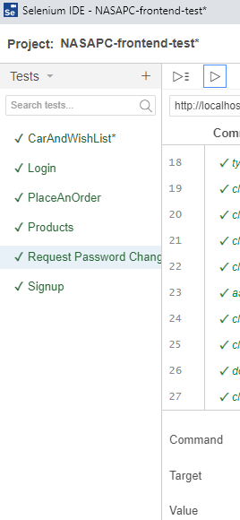
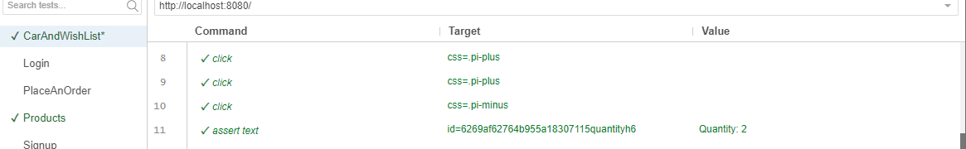
Selenium
Frontend Test

Slide 10
Backend
Backend showcase
Register & Verify Account
Login & Authentication
Password Request & Change
WishList
Orders
Reviews
Admin
Adding a new product
Modifying a product
Deleting a product
Testing
Conclusion
Difficulties
What I’ve learned
Future project plans / improvements

Slide 11
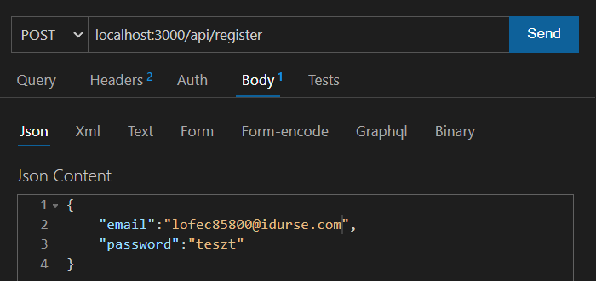
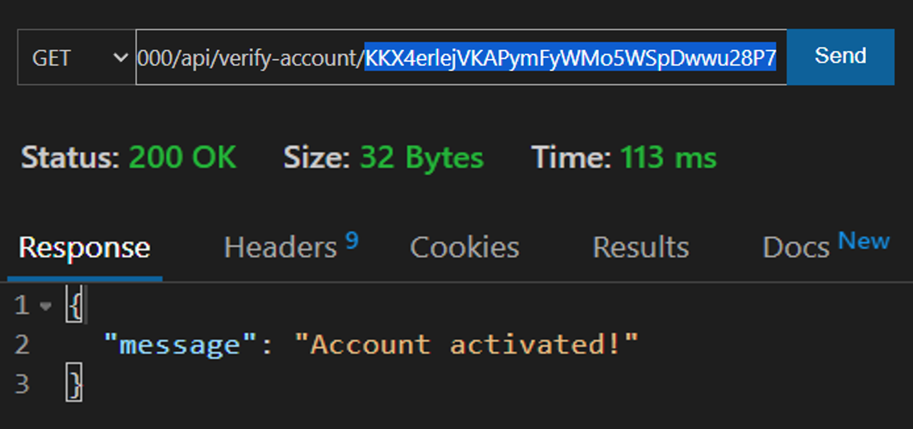
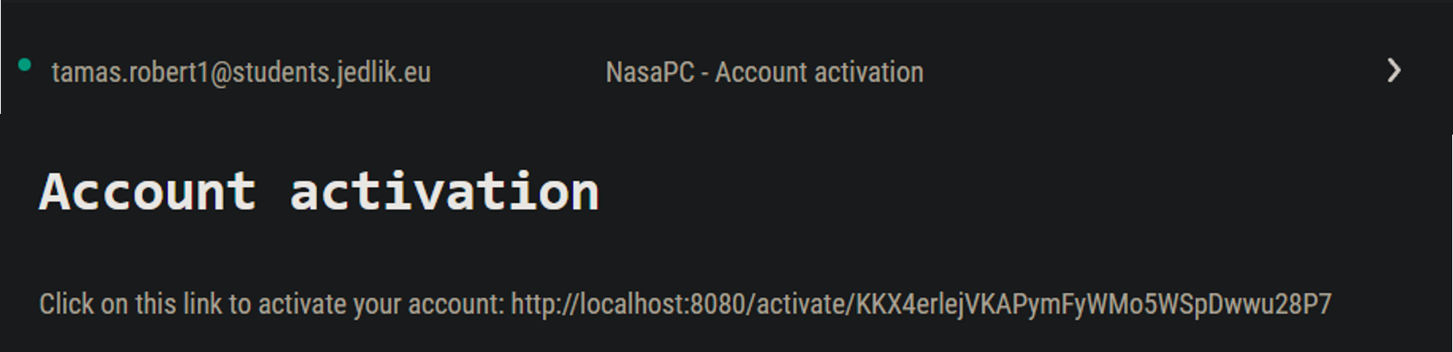
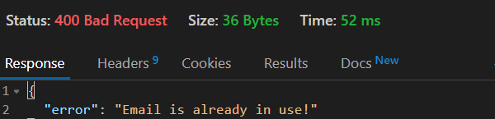
Backend showcase
Register & Verify Account

Slide 12
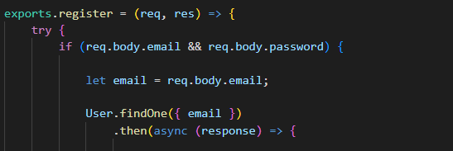
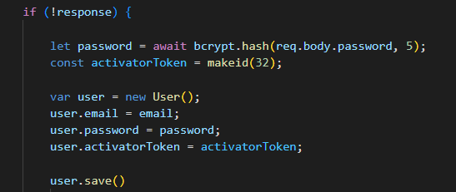
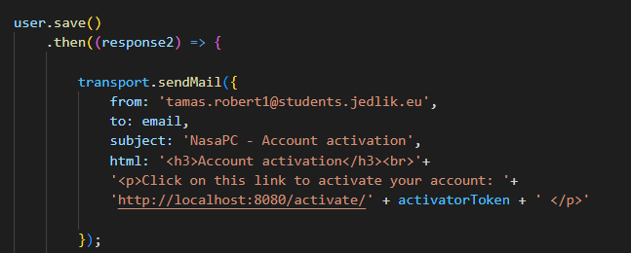
Backend showcase
Register & Verify Account

Slide 13
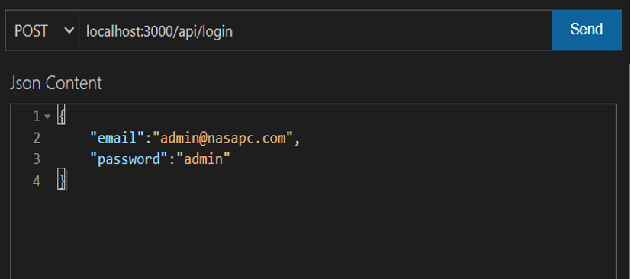
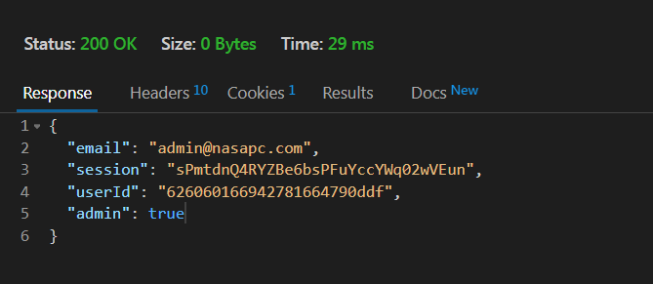
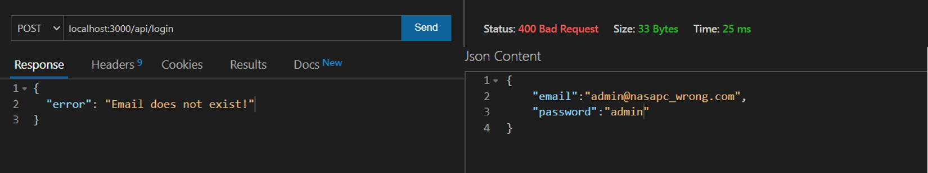
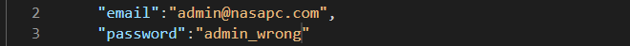
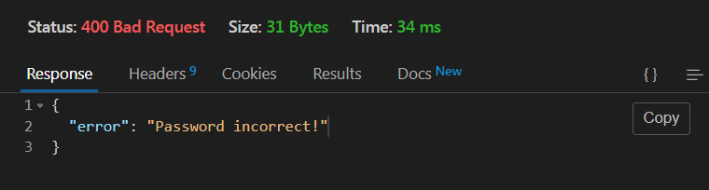
Backend showcase
Login & Authentication

Slide 14
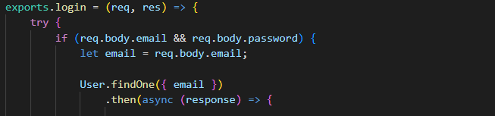
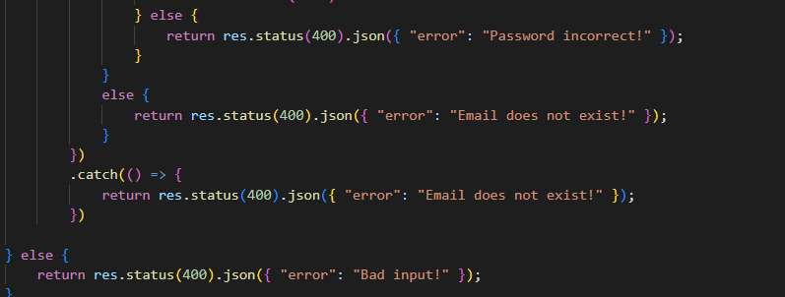
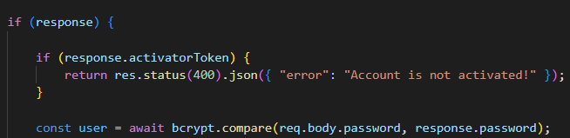
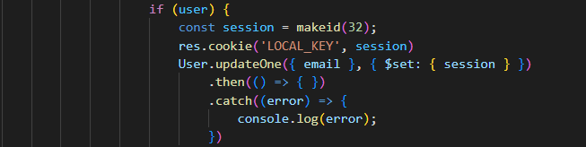
Backend showcase
Login & Authentication

Slide 15
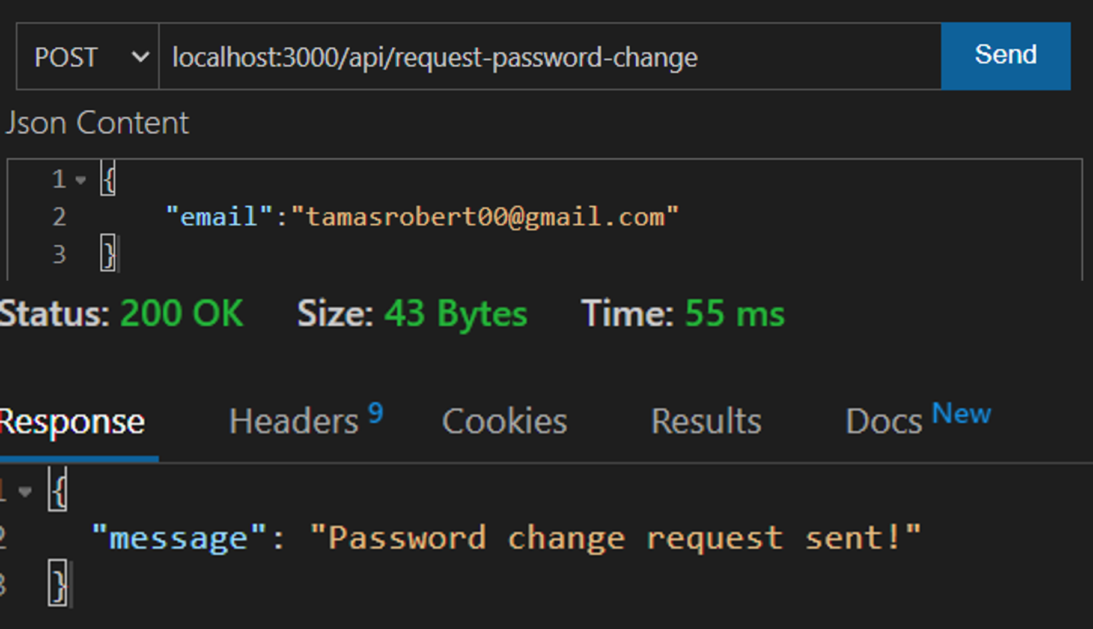
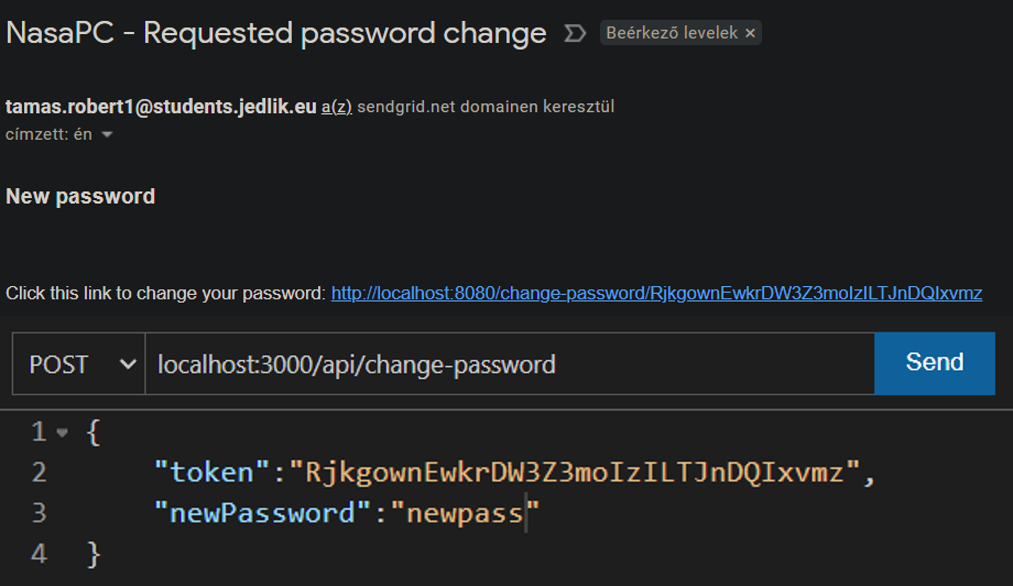
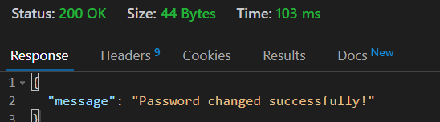
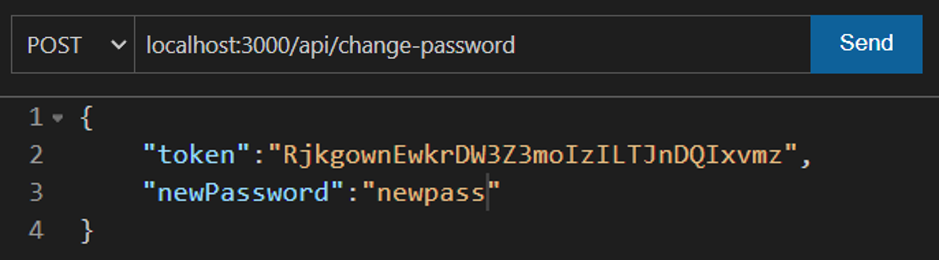
Backend showcase
Password Request & Change

Slide 16
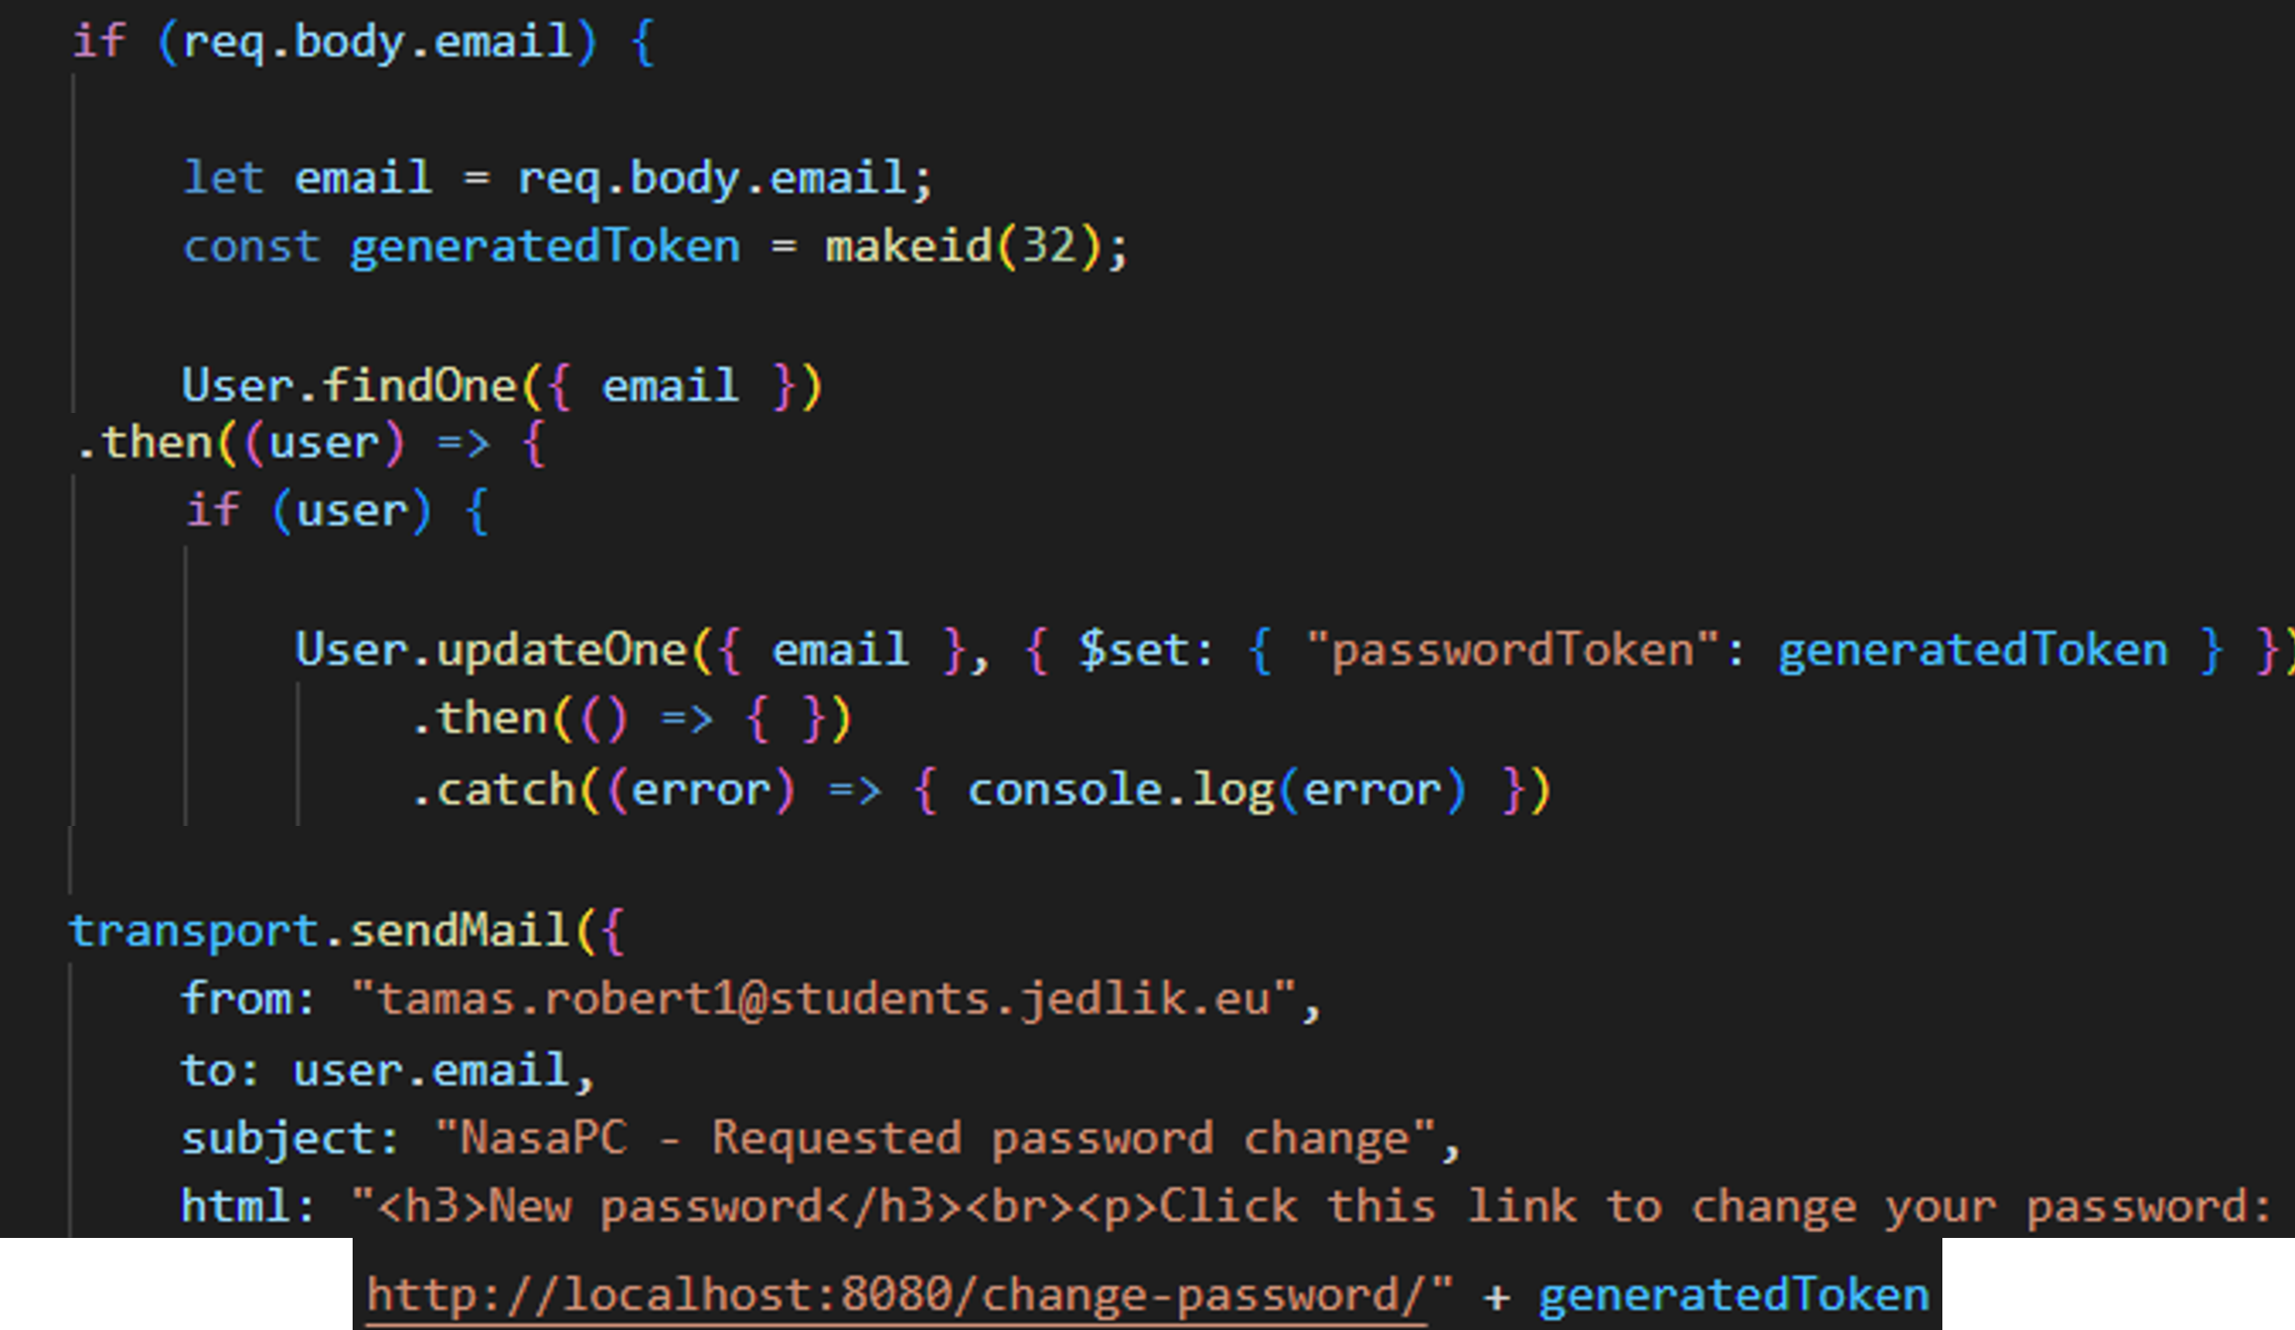
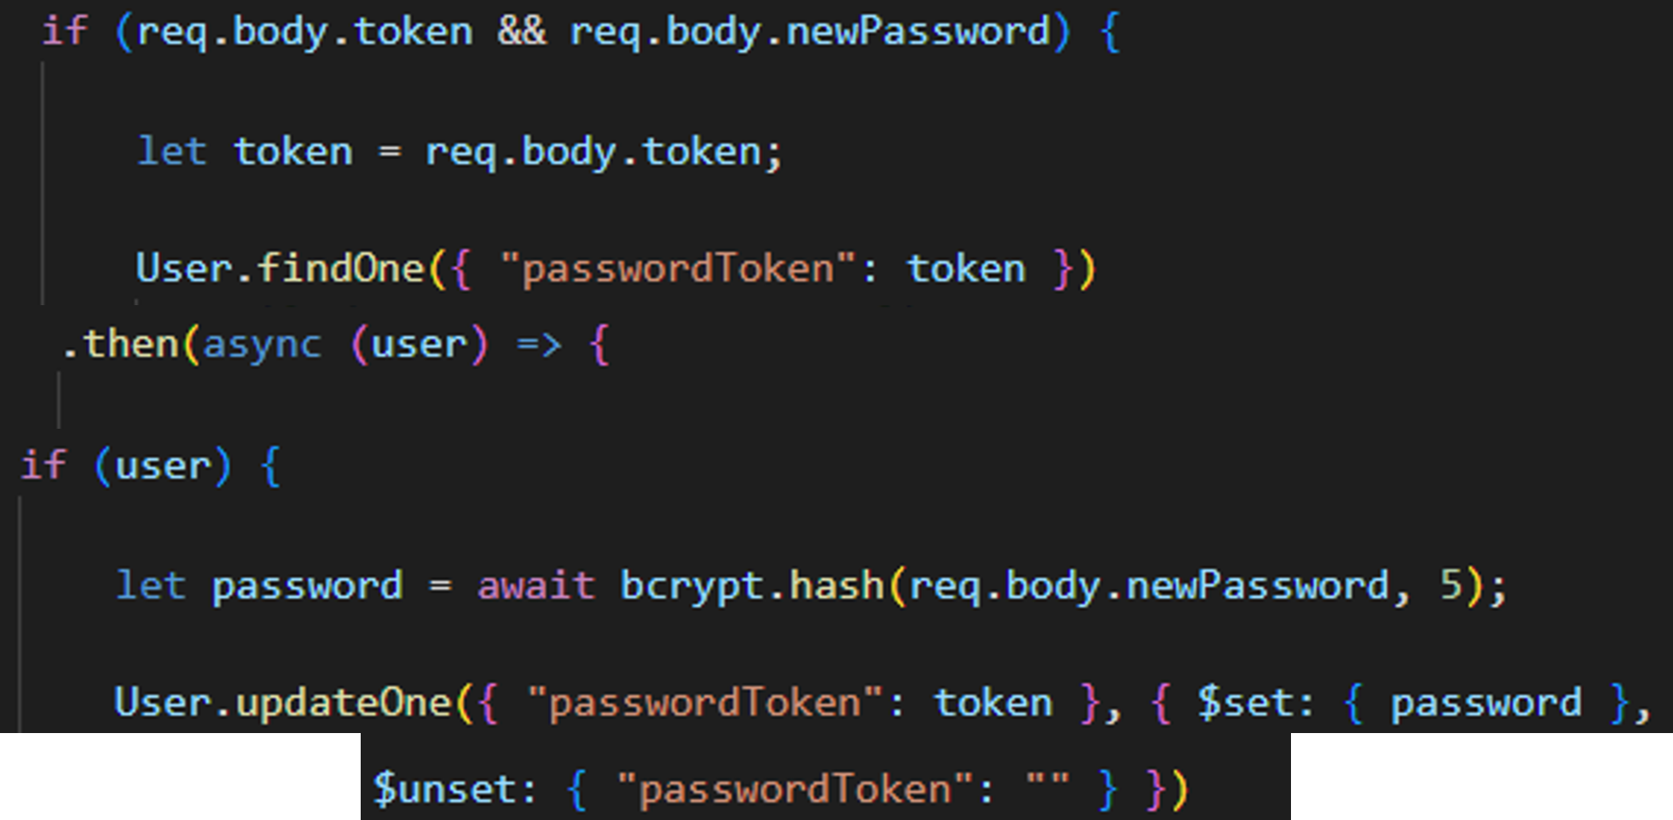
Backend showcase
Password Request & Change

Slide 17
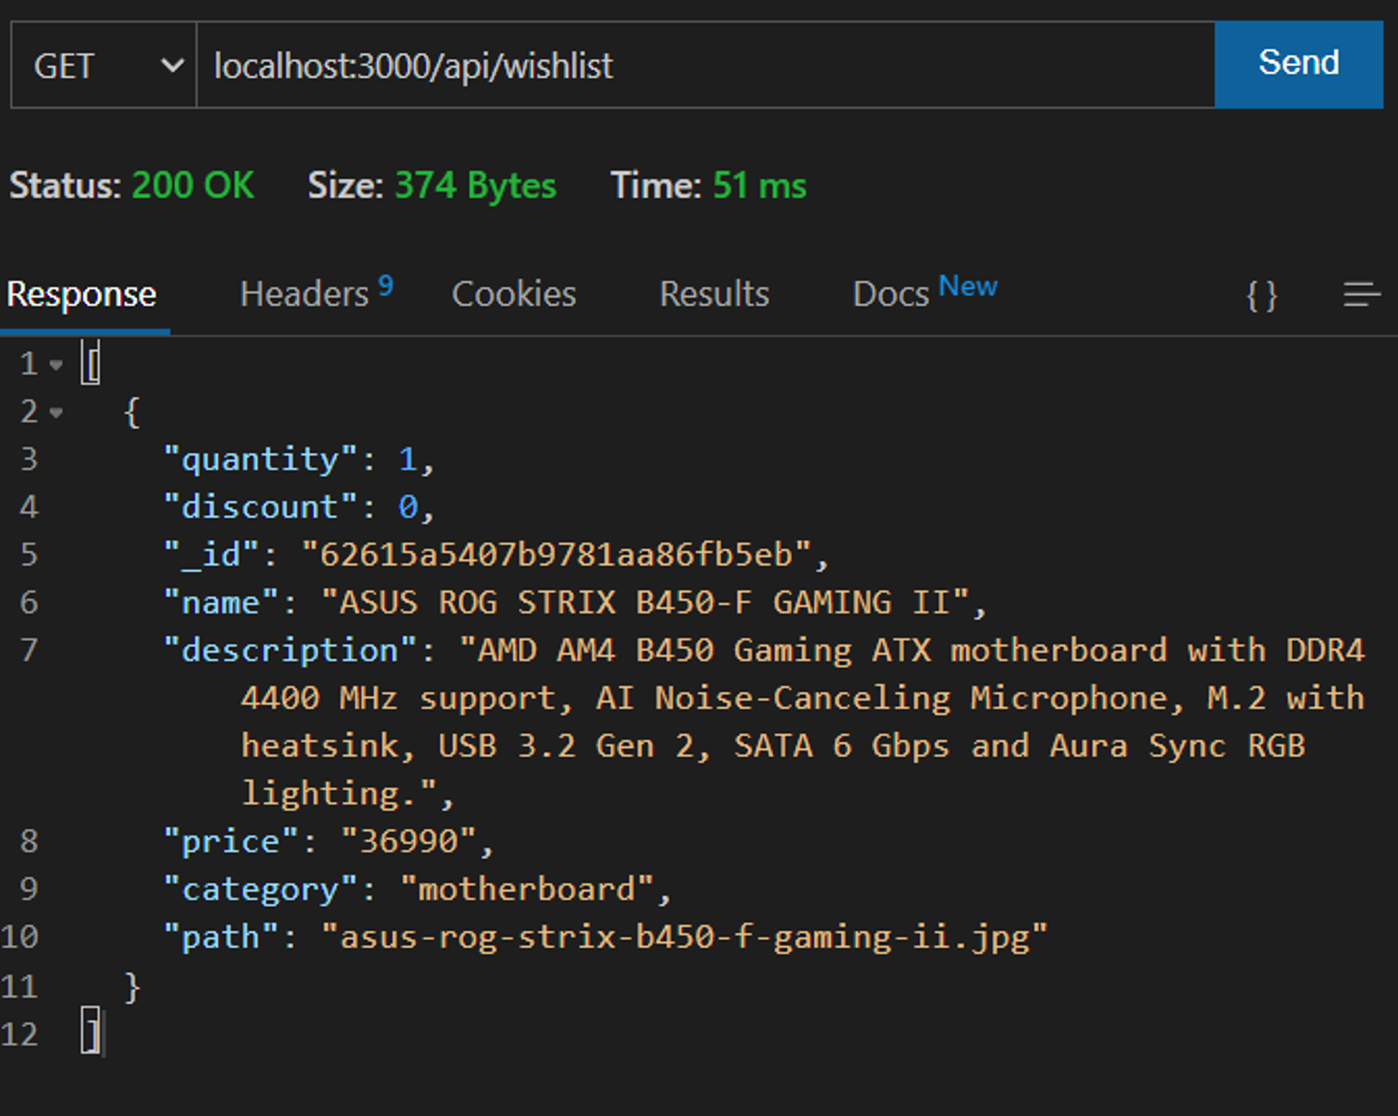
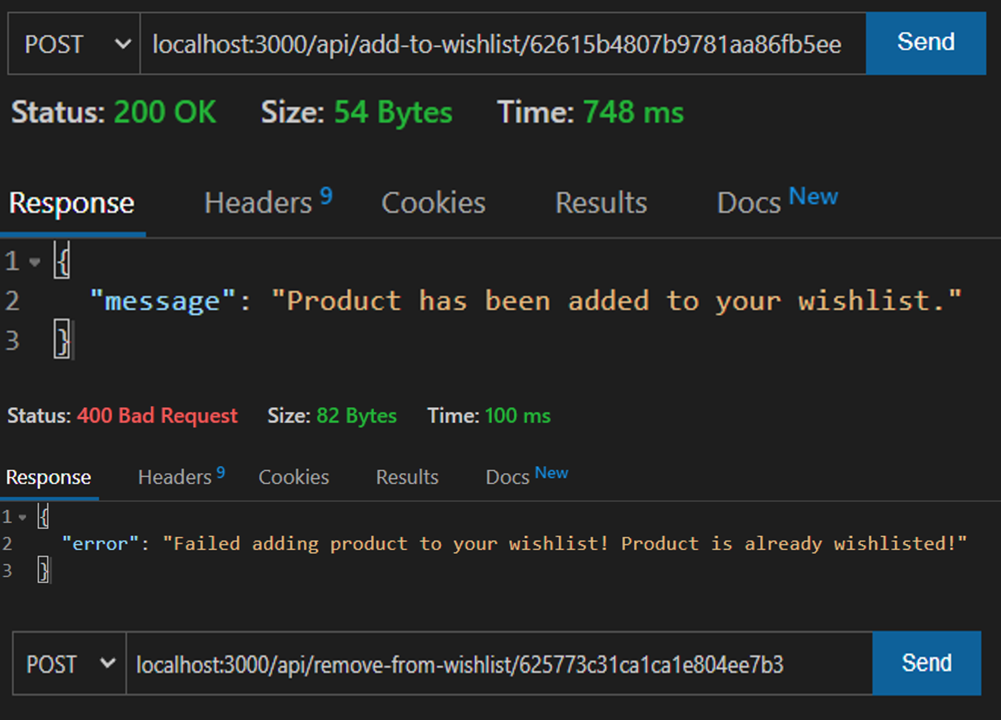
Backend showcase
WishList

Slide 18
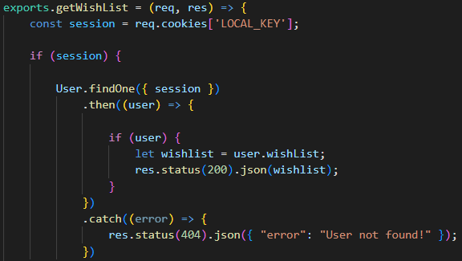
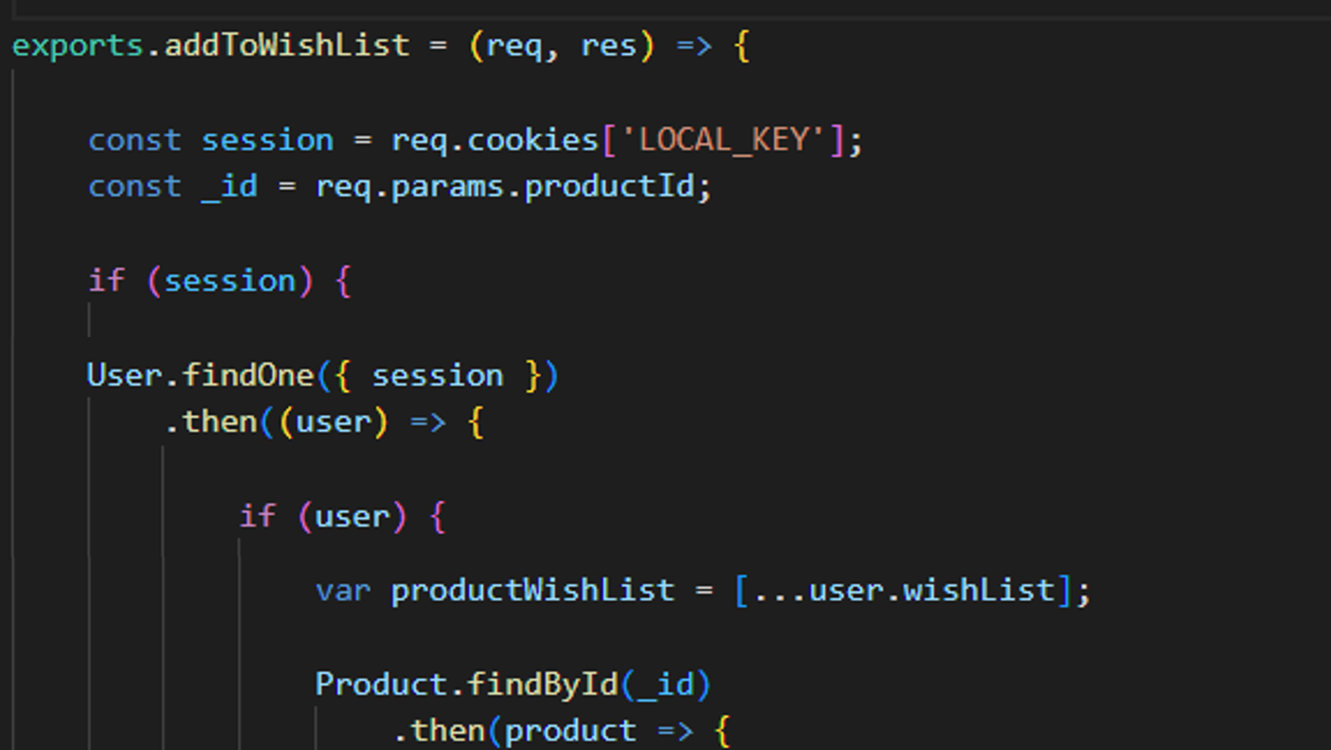
Backend showcase
WishList
(Code 1/4)

Slide 19
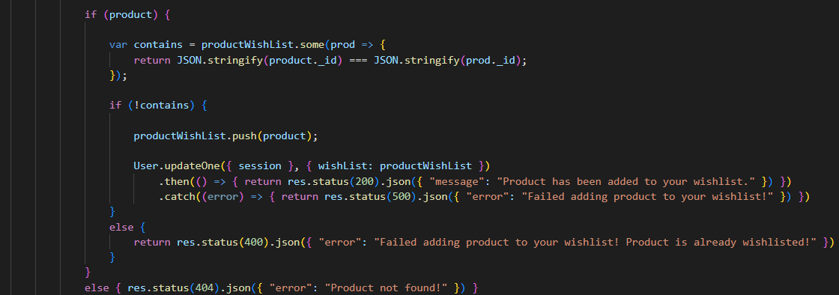
Backend showcase
WishList
(Code 2/4)

Slide 20
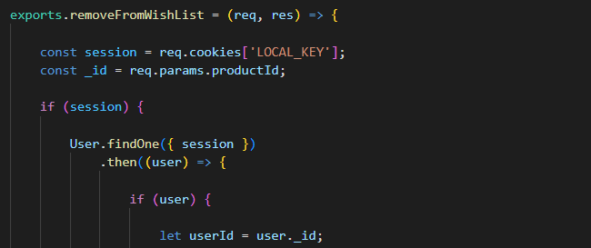
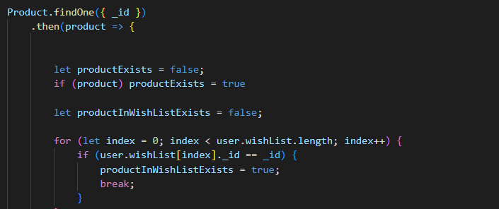
Backend showcase
WishList
(Code 3/4)

Slide 21
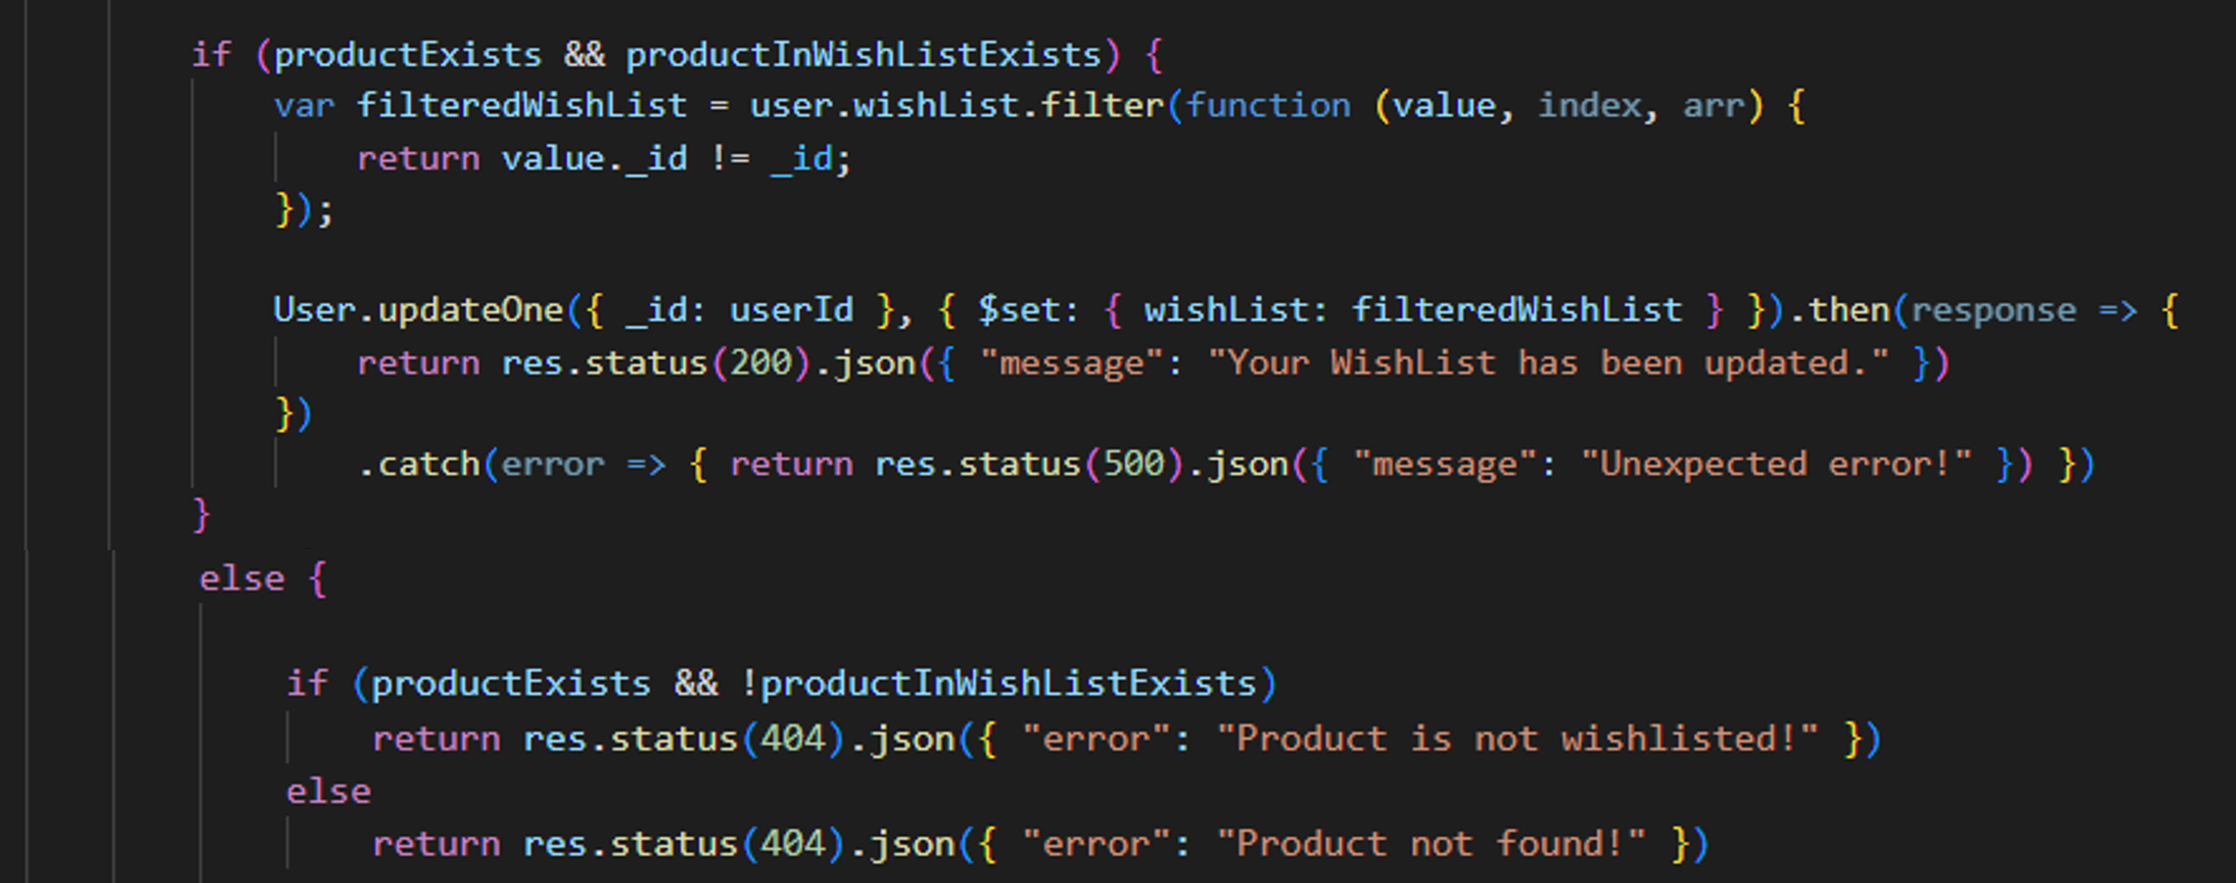
Backend showcase
WishList
(Code 4/4)

Slide 22
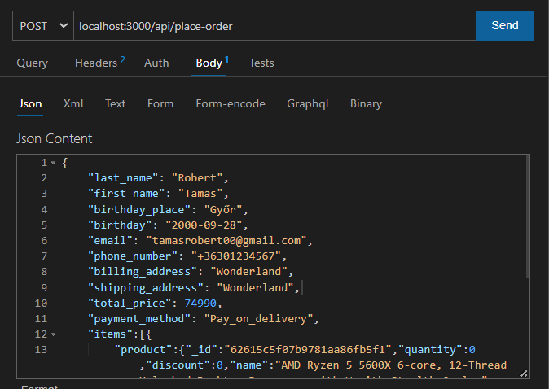
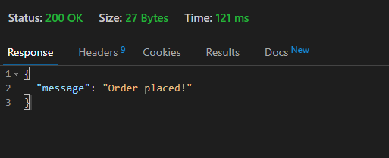

Backend showcase
Orders

Slide 23


Backend showcase
Orders

Slide 24




Backend showcase
Reviews

Slide 25


Backend showcase
Reviews
Add review
Delete review

Slide 26



Backend showcase
Admin
modify-product
add-product
delete-product

Slide 27



Backend showcase
Testing

Slide 28
Backend showcase
Conclusion
Difficulties
What I’ve learned
Future project plans / improvements

Slide 29
Android App
Android App overview
Advantages
Menus
Order process
Android App conclusion
What I’v learned
Future development

Slide 30

Android App showcase
Advantages
The application allows the user to get a more transparent interface than if they had to view it on a web page.
An application can has much more potential in functionality, because it can use more tools like fingerprint scanner for authentication, or QR code scanner.
Faster access: users don’t need to type the website’s address like in the browser.
We can send notifications to the user if a product is on sale or if there’s other news to tell.

Slide 31

Android App showcase
Menus

Slide 32

Android App showcase
Ordering process

Slide 33

Android App showcase

Slide 34

Android App showcase

Slide 35
Android App
Conclusion
Difficulties
What I’ve learned
Future project plans / improvements

